Slide 1
Preliminary Results From A Prospective Real-World Multicenter Clinical Practice Of CAS Using The CGuard EPS: The IRONGUARD 2 Study
Pasqualino Sirignano
Vascular and Endovascular Surgery Division
Department of Surgery “Paride Stefanini”
Policlinico Umberto I
“Sapienza” University of Rome
Chief Prof Francesco Speziale

Slide 2
Conflict of Interest
I have nothing to disclose

Slide 3
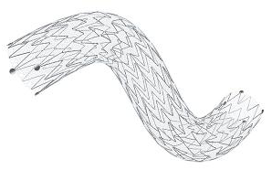
Starting Point

Slide 4
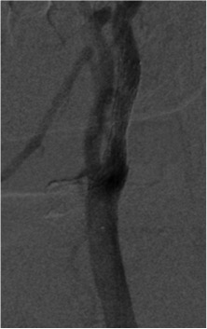
Starting Point
April 2015 – June 2016
200 enrolled patients
Technical Success: 100%
MACCE=0
5 minor strokes
2 TIAs
EuroIntervention 2018

Slide 5
@ 1 Year IRONGUARD

Slide 6
@ 1 Year IRONGUARD
No major neurological adverse event
No stent thrombosis
No ECA occlusion
EuroIntervention. 2018

Slide 7
Enrollment
2
So we decide to continue our experience with a NEW registry:
733 Patients
in 20 enrolling Italian Centers

Slide 8
Demographic
Age: 73.03±7.84yy (48-97)
Male Gender: 516 (70.39%)
Tobacco Abuse: 439 (58.52%)
Diabetes: 264 (36.01%)
Hypertension: 622 (84.85%)
Dyslipidemia: 429 (58.52%)
CAD: 278 (37.92%)
Unpublished Data

Slide 9
Symptoms
131/733 patients (17.87%) were symptomatic
96 TIA (73.28%)
23 Minor Stroke (17.55%)
12 Major Stroke (9.17%)
Major Stoke
Minor Stoke
TIA
Unpublished Data

Slide 10
Target Lesions
Stenosis
84.97±6.51%
(50-99)
Unpublished Data

Slide 11
Plaques Composition
Hyperechoic 163 (22.2%)
Hypoechoic 181 (24.7%)
Isoechoic 107 (14.6%)
Disomogeneous 172 (23.4%)
Ulcerated 40 (5.5%)
Thin fibrous Cap 29 (4%)
Post-CEA restenosis 41 (5.6%)
>50% presented an
high-risk carotid plaque
Unpublished Data

Slide 12
Arch Anatomies
Type I 369 (50.3%)
Type II 268 (36.6%)
Type III 39 (5.3%)
Bovine 57 (7.8%)
All aortic arch morphologies were enrolled in the study
Unpublished Data

Slide 13
Arch Anatomies
Thrombosis 20%
Calcifications 27.1%
Moderate/Severe Tortuosity 34.6%
1/3 of enrolled patients presented significant supra-aortic vessels tortuosity
Unpublished Data

Slide 14
Procedural Details
Almost in all cases a transfemoral approach was chosen (97.27%), while also brachial (1.63%) and transcervical approaches (1.11%) are reported
Unpublished Data

Slide 15
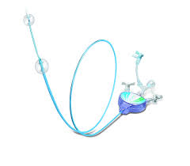
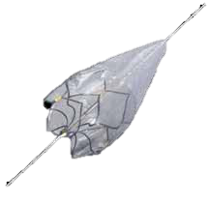
Procedural Details
Embolic Protection Device was adopted in 99.72% of patients:
proximal occlusion device (Mo.Ma.) in 14.62%, and distal filter in 80.9%
Unpublished Data

Slide 16
Procedural Details
Procedural success was 100%, technical success was obtained in all but one patient (99.86%) due to the impossibility to advance the CGuard EPS system: patient was consequently treated by Carotid WallStent.
Unpublished Data

Slide 17
@ 24 hours Results
1 fatal haemorrhagic stroke
(urgent Patient treated for cTIA)
2 Minor Strokes
6 TIAs
1 AMI
No Death
8 ECA occlusions (1.09%)
Unpublished Data

Slide 18
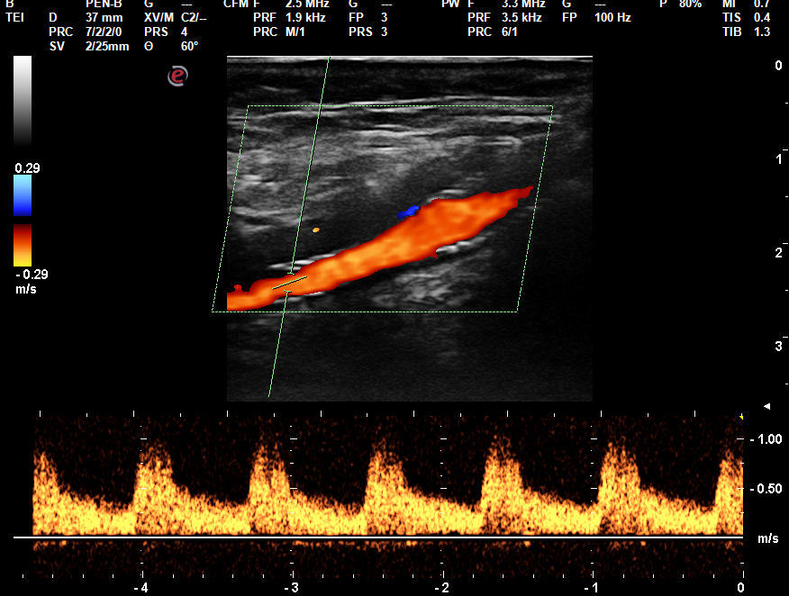
@ 30 days Results
1 Minor Stroke
2 TIAs
3 AMI
No Death
No stent thrombosis/occlusions
VPS 89,8 cm/s
Unpublished Data

Slide 19
Cumulative @1-month
@ 1 Month Results
Stroke rate 0.54%
(3 Minor Strokes, 1 haemorrhagic)
TIA rate 1.09%
Cumulative neurological event rate 1.63%
Unpublished Data

Slide 20
@ 1 year Results
Data available on 253 Pts
2 new MACE: 2 IMAs (fatal), no new neurological event
7 Deaths: 2 AMI, 4 neoplasms
1 Suicide
ACE patency 95.65%
Unpublished Data

Slide 21
Conclusions
On going analysis!!!

Slide 22
Thanks to all
Domenico Palombo
Sonia Ronchey
Massimo Ruggeri
Maria Antonella Ruffino
Pasqualino Sirignano
Francesco Spinelli
Eugenio Stabile
Massimo Sponza
Maurizio Taurino
P.I. Francesco Speziale
Laura Capoccia
Michelangelo Ferri
Bruno Gossetti
Franco Intrieri
Arnaldo Ippoliti
Wassim Mansour
Paolo Mortola

Slide 23
Symposium Chairman
Francesco Speziale
Scientific Secretariat
Wassim Mansour
Pasqualino Sirignano
Vascular and Endovascular
Surgery Division
Department of Surgery
“Paride Stefanini”
“Sapienza” University of Rome
Policlinico Umberto I
e-mail: caput.meeting@gmail.com
Save the date

